Slide 1
Observability at scale
Running OpenTelemetry across an enterprise
Jonah Back - Principal Software Engineer @ Intuit
Kranti Vikram - Staff Software Engineer @ Intuit

Slide 2
AGENDA:
Our Journey towards Distributed Tracing
Collection & Instrumentation
Trace Metrics Extractor [Extension to OpenTelemetry collector]
Tracing’s role in reducing MTTR and MTTD

Slide 3
Case of change at Intuit
We rarely identified the right service and type of failure at first shot
Serverless
Containers
Hybrid hosting
Had a primitive tracing mechanism - services were required to propagate an ‘intuit_tid’ header.
Service mesh
Customers
3rd parties
Cloud resources
App stacks
EC2 instances

Slide 4
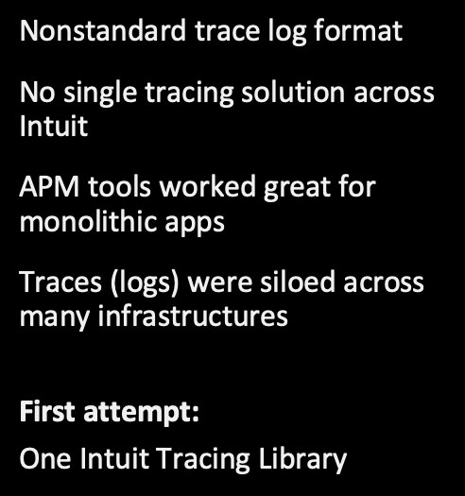
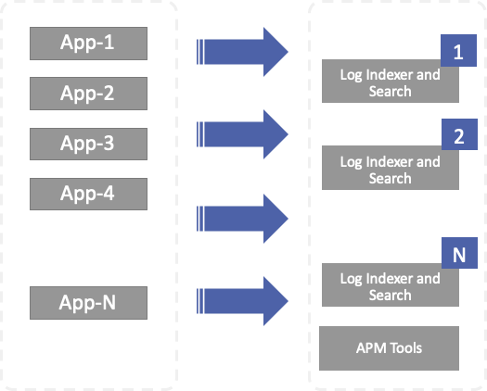
Our Journey towards Opentracing
Notes:
Problem – Legacy One Intuit Tracing library didn’t follow any open standard; impossible to move 100s of services to adopt opentracing library
Solution – Created a new version of library (backward compatible) adhering to opentracing specs
Benefit – Immediate conversion to opentracing for 100s of services by simply flipping the version number

Slide 5
Role of observability in reducing outage duration
Outage budget: 22 mins per month
MTTR (Time to repair/recover)
Impact
started
Incident
response
begins
Correct
service &
team engaged
Root cause &
solution
identified
Fix implemented
& customer
impact has
ended
Full redundancy
restored
MTTD (Detect)
Recover
Fully restored
MTTI (Isolate)
MTTS (Solution)
MTTI (Implement)
$$ Observability $$
Notes:
Let’s look at the role of observability in reducing outage duration.
The average time it takes to repair or recover from an incident is called MTTR (Mean time to recover). At Intuit, our goal is to not exceed 22 minutes of downtime in a given month (this is based on our uptime goal of 99.95%) What does it mean? If we have one incident in a month, our goal is to recover within 22 minutes. If we have 2 incidents, our budget cuts down 50% to 11 minutes each so we have very aggressive target for MTTR.
The first part of MTTR is the time to detect an incident (MTTD). It’s the time it takes for an incident to be detected ideally by a machine or a human being so it’s all about how quickly you get your first alert.
The recovery phase has 3 parts to it.
Time to Isolate – It’s the time the team takes to identify the right service and engage the right team. As we live in In a micro service environment with numerous dependencies, we tend to play hot potato game by passing the responsibility to another team until we find the right culprit.
After identifying the right service and team, next comes, the MTTS (Mean time to Solution), it is not enough to just find what service is causing the problem but also why it is causing the problem. A recent release deployment or configuration change which could be fixed by a simple roll back. A specific issue happening in only one region that would require region failover or a 3rd party vendor that your system depends on has failed, the only solution here is that you need to pull some contingency. Once you understand the problem and has a solution, the final stage is implementing it.
Observability plays a huge role in detection, isolation and solution stages. If you don’t have the right set of tools in these phases, you are looking at very long time for recovery.
Today we will see how Intuit has been using various AWS services to build various capabilities as part of Observability Platform.

Slide 6
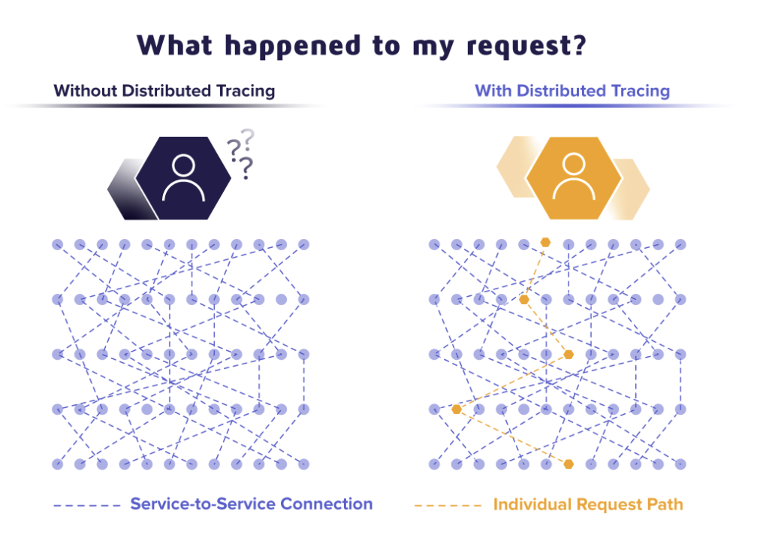
Distributed Tracing
Notes:
Distributed tracing is a method used to profile and monitor applications, especially those built using a microservices architecture. Distributed tracing helps pinpoint where failures occur and what causes poor performance.
It provides End to End visibility and reveals service dependencies to instantly isolate a problem and conduct performance analysis.

Slide 7
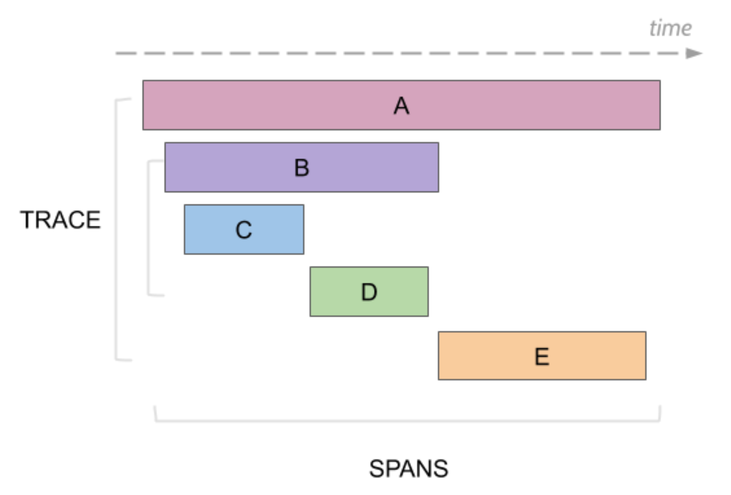
Distributed Tracing
Process of tracking the journey of a request through each microservice, in near real time.
Span - Usually represents when one service invokes another.
Trace - A collection of spans, representing the entire journey of a request.

Slide 8
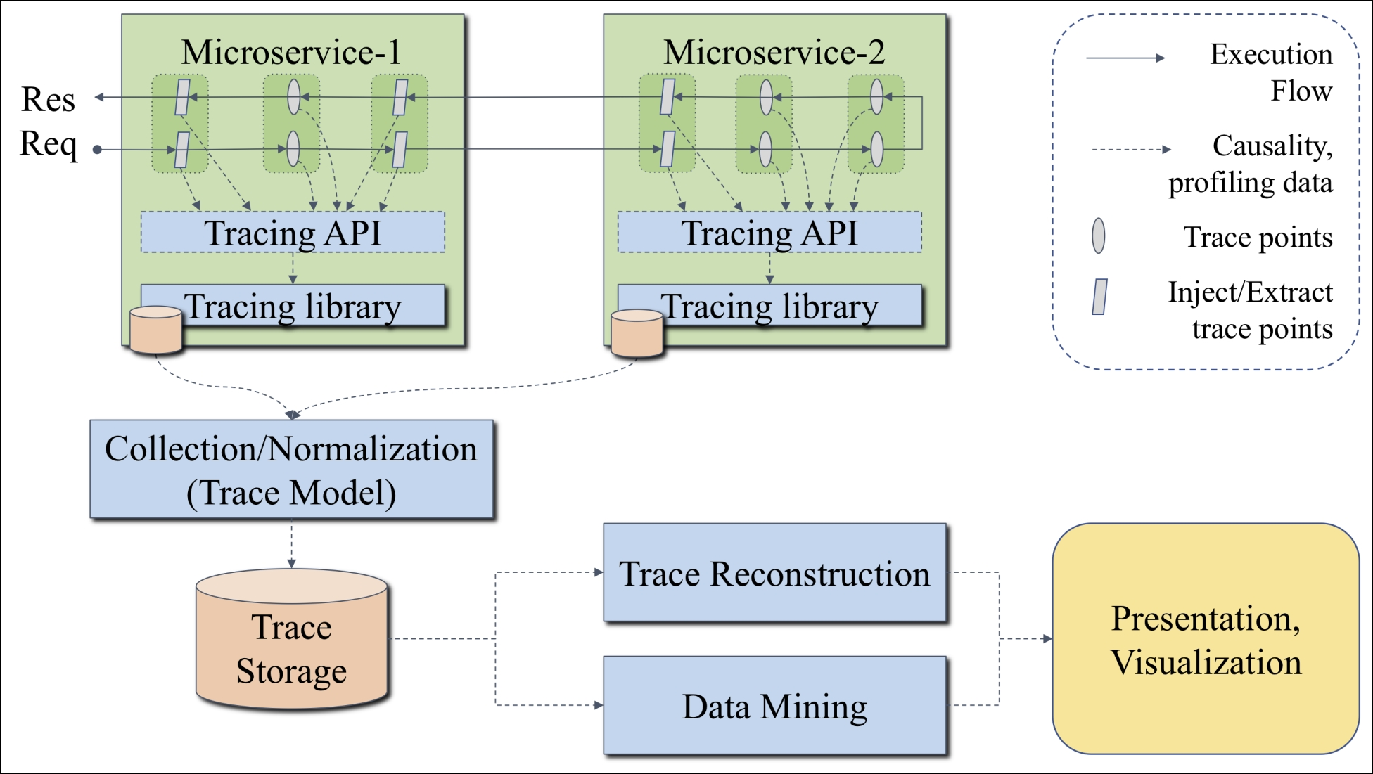
Distributed Tracing Architecture

Slide 9
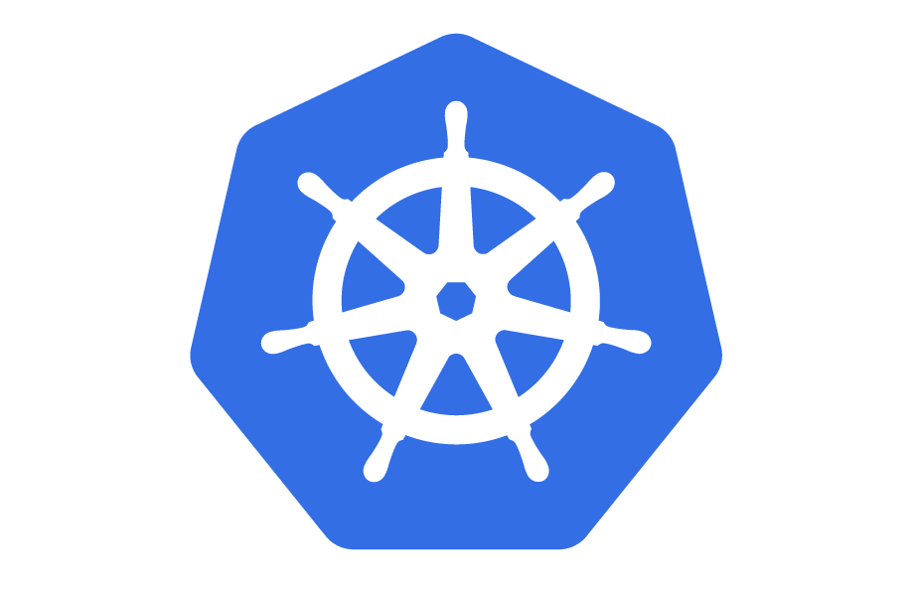



Tracing Deployment View
K8s node
Tracing UI
POD
POD
POD
Opentelemetry Agent
gRPC with TLS over AWS PrivateLink
K8s node
K8s node
gRPC
POD
POD
EC2
Jaeger Collector
Trace Store
App
OpenTelemetry Collector
Opentelemetry Agent

Slide 10
span {
parentID:NULL,
traceID:101,
id:S101,
kind: SERVER
}
span {
parentID:S101,
traceID:101,
id:S102,
kind: SERVER
}
span {
parentID:S102,
traceID:101,
id:S103,
kind: SERVER
}
Order
[In-Progress]
Allocation
[In-Progress]
Billing
[In-Progress]
REQUEST
Order
REQUEST
Allocation
REQUEST
Billing
RESPONSE
RESPONSE
RESPONSE
span {
parentID:S101,
traceID:101,
id:S102,
kind: CLIENT
}
span {
parentID:S102,
traceID:101,
id:S103,
kind: CLIENT
}
OtelAgent
OtelAgent
OtelAgent
Zipkin
Jaeger
OpenCensus
Open Telemetry Collector
Zipkin
Jaeger
Trace Store
Analytics/Visualization
Notes:
Let’s see a brief overview of the components involved .
On application end :
The process involves generation of spans from each application. This can be done by instrumenting an application.
The request reaches the first application, this is where the server span is generated.
This triggers another request to the Allocation service, leading to generation of another server span. And similar for the next application.
Now, when the response is returned, a client span is generated in allocation Service. And similar for the first service - order.
All the spans ultimately land up in the trace store.
At the bottom, there’s an OpenTelemetry collector -- which can accept spans in Zipkin, Jaeger & other formats and transform to another format as required.
This sends Jaeger - an Open Source Solution by Uber
OpenTelemetry Collector sends spans to Jaeger collector, which ultimately sends it to a data store.

Slide 11
Metrics

Slide 12
System resource metrics – K8s node/pod CPU, memory metrics
AWS resource metrics (Amazon RDS, Amazon ES, Amazon DynamoDB, etc.) – CloudWatch
Transaction metrics – RED (request rate, error rate, duration)
Real user monitoring (RUM) metrics – failed customer transactions, page load time, etc.

Slide 13
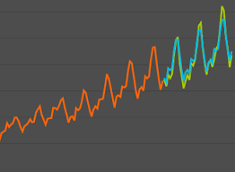



Tracing Deployment View
Time Series Data Store
[Dashboarding & Alerting]
K8s node
Metrics Aggregator
Tracing UI
POD
POD
POD
<publish>
<subscribe>
Metrics Stream
Opentelemetry Agent
K8s node
K8s node
grpc
grpc
POD
POD
EC2
Jaeger Collector
OpenTelemetry Collector
Trace Store
App
Opentelemetry Agent

Slide 14
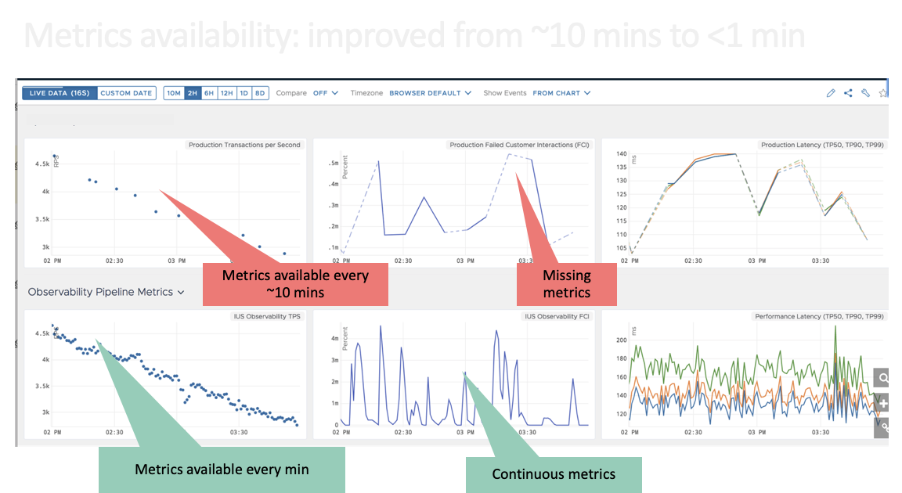

Slide 15
Benefits of Traces and Trace Metrics

Slide 16
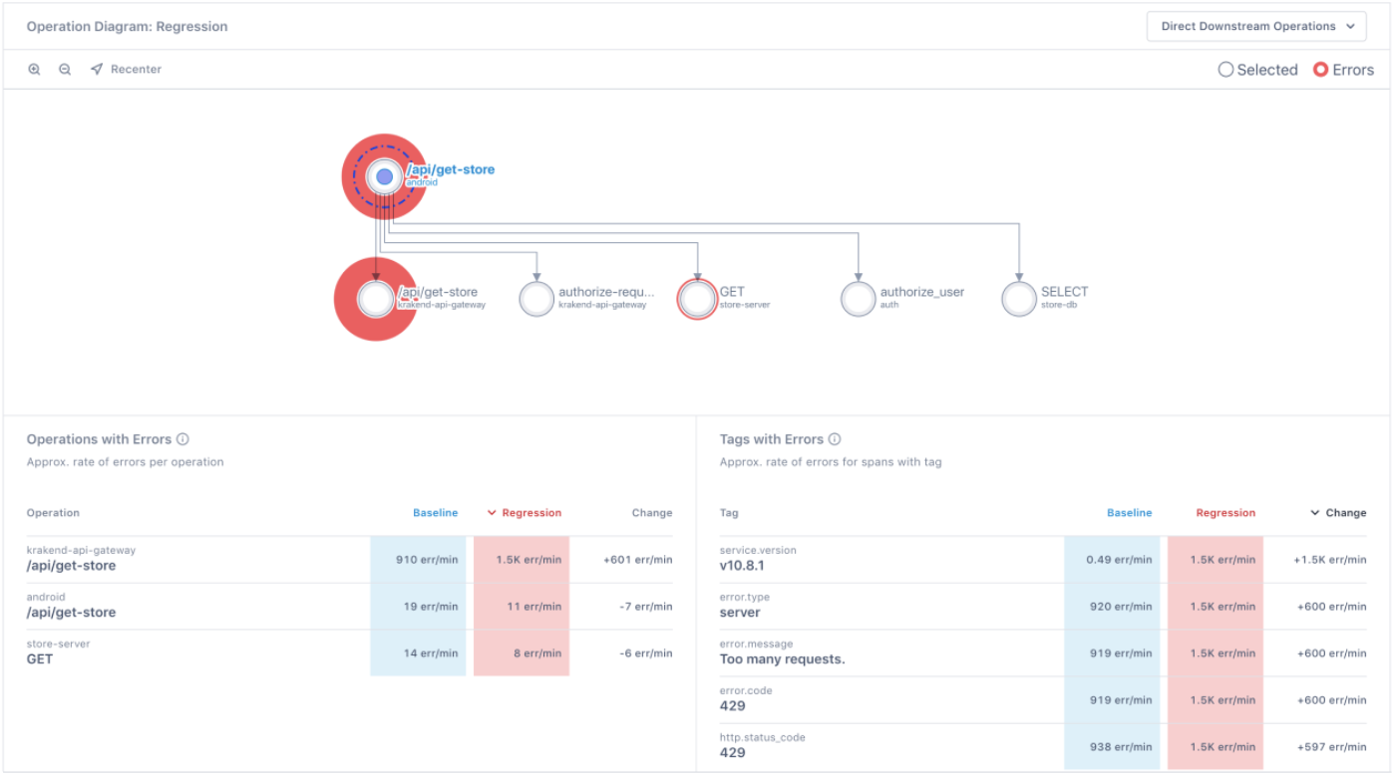
Quick identification of slow or faulty services -MTTR
High level topology view helps to quickly identify slow and erroneous systems.
Autocorrelation enables to identify impacted APIs and root cause quickly.

Slide 17
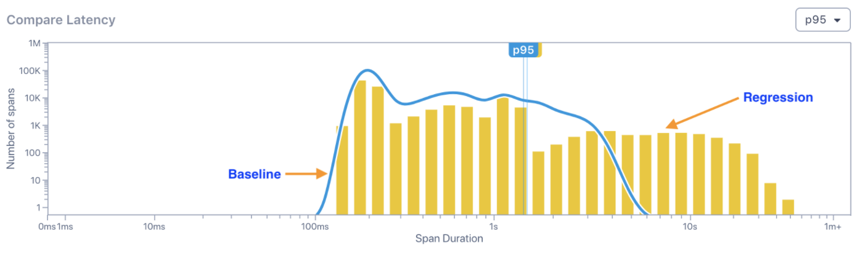
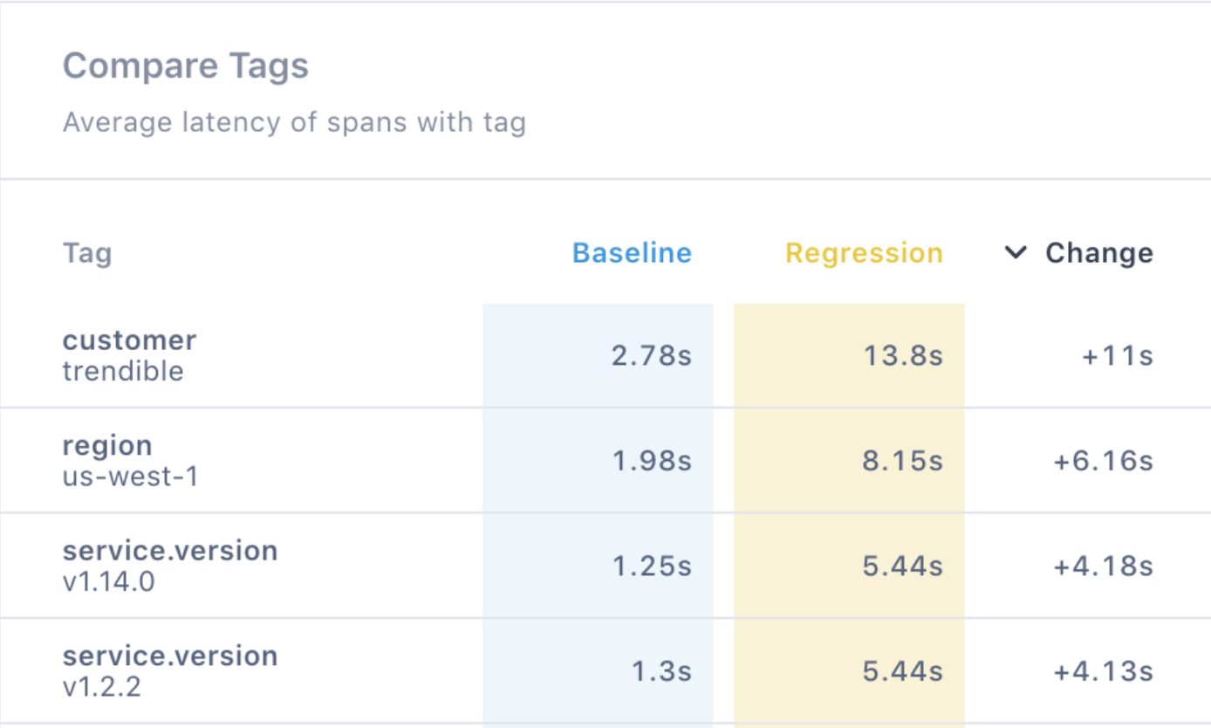
Performance Analysis
Performance Analysis
Aggregated TPS, TP latency metrics at Service and API level - enabling comparison between current and past baselines (hour before, day before, week before)
Deployment Regressions, Canary rollouts

Slide 18
Q & A
Thank You!!!

